Slide 1

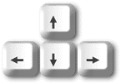
Cancel
Learning

Slide 2

Cancel
Learning

